Slide 1
Clothes type classifier
Computer Vision Task

Slide 2
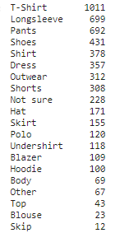
Dataset
Over 5000 images
20 classes
Classes counts

Slide 3
Data Handling
Reading images.csv file
- Adding extension .jpg to image columns
- Creating DataFrame containing only image ID, and label
- Mapping class name to class number
- Splitting data to train and test
- Creating train.csv file, and test.csv file
- Creating Dataset class

Slide 4
Data handling (cont.)
Creating transform function
resizing all images to fixed size
converting images to tensors with value from zero to one
initializing instances(trainset, testset) from Dataset class
initializing trainloader and testloader
mapping trainloader and testloader to train and test in dataloader
Installing vgg16(Architecture and pre-trained weights)

Slide 5
Transfer Learning
since the dataset is a small dataset, then building network and run it from scratch will cause overfitting
used vgg16 trained on ImageNet as a pre-trained network

Slide 6
Vgg16 adjustment
Freezing the body of the network
removing the head layers
adding new layer in the head including conv2d, RelU, AdaptiveAvgpool2d, and final dense layer

Slide 7
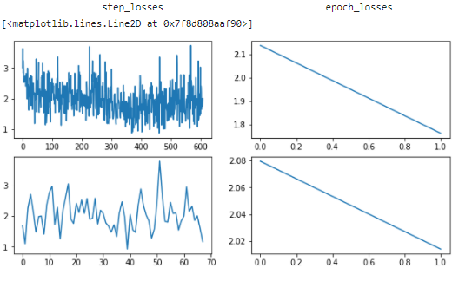
Training the data - 3 epochs
loss decreasing
training accuracy increasing
testing accuracy is almost fixed
(indication to almost overfitting!)
training acc. = 0.56
testing acc. = 0.42

Slide 8
Unfreezing the body layers, training 3 epochs
loss decreasing first then had a little change
training acc. = 0.18
testing acc. = 0.20
need more epochs!

Slide 9
Unfreezing the body layers, training another 5 epochs
loss is almost fixed, stucking in local minimum

Slide 10
Added 2 epochs - SGD(lr = 0.1, momu = 0.9)
change optimizer to SGD with learning rate = 0.1 and momentum = 0.9 (Trying to go out of local minimum)
loss is still fixed, stucking in local minimum too

Slide 11
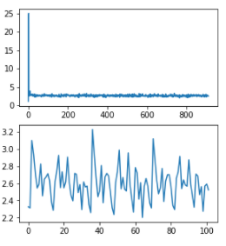
Freezing the body again, 5 epochs
loss is still fixed

Slide 12
Ignoring learned parameters and training with initial weights of vgg16, 10 epochs, body freezed
loss decreasing over epochs
training acc. = 0.83
testing acc. = 0.44
overfitting!

Slide 13
To-Do next
Collecting more data
Making data balanced
Decreasing number of classes
Data Augmentation

